Slide 1
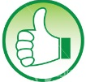

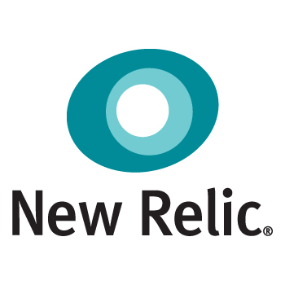

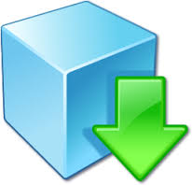





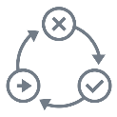


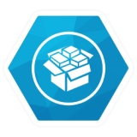



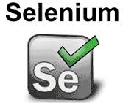

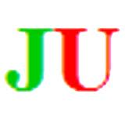


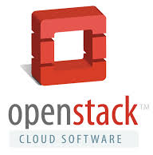




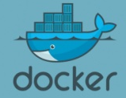












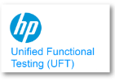
DevOps Automation View
Create additional slides with Container Flavor (With AWS/Open Shift)
Monitoring & Control
SignOff
Deployable Software
Production Environment
Compile
Unit Test
Static Analysis
Packaging
Deployable Software
Compile
Unit Test
Static Analysis
Packaging
Commit Stage
Commit Stage
Load Testing
Load Testing
Source Code Repository
Environment Provisioning
Source Code Repository
Environment Provisioning
Development & Configuration
Development & Configuration
Perf Testing
Perf Testing
Release Stage
System of Records – Service Virtualization
Release Stage
System of Records – Service Virtualization
IDE’s – Eclipse, etc
Client / Prod. Owner
Project / Task Management
Project / Task Management
Ready to release Software
Acceptance Test
Ready to release Software
Acceptance Test
SignOff
SignOff
Acceptance Stage
Acceptance Stage
Load + Perf Stage
Load + Perf Stage

